Slide 1
Library Management System
By

Slide 2
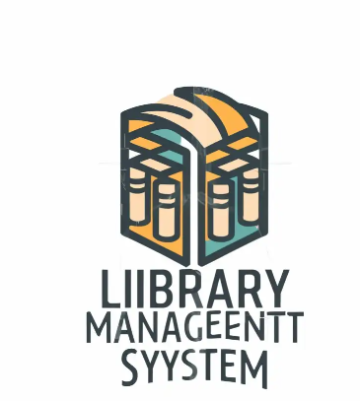
Project Overview
In this project, we developed a Library Management System to streamline book borrowing, returning, and reservation processes.
Our system ensures efficient handling of overdue fines, optimizes resource availability, and enhances user experience through structured database management
Undoubtedly traditional library management procedures like manual procedures brings difficulties to handle the books and also bookings
It is essential to integrate information system approaches to streamline the library management activities
The main goal of this project is to provide a robust and well-integrated system that manages library operations seamlessly.
We focused on two major use cases: borrowing books and returning books with fine calculation for overdue items.
The system ensures data integrity, enhances user accessibility, and automates manual operations.

Slide 3
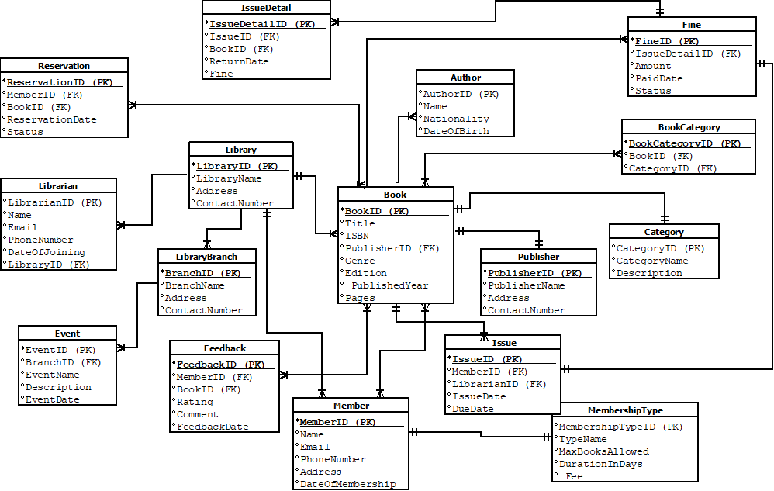
ERD Diagram
We designed an Entity-Relationship Diagram (ERD) to structure our database effectively.
It defines the relationships between core entities such as Books, Members, Issues, Reservations, and Fines.
This ERD serves as the foundation for our database schema and ensures smooth implementation.

Slide 4
ERD- Key Relationships
We implemented well-defined relationships between entities to maintain data consistency. Some key relationships include:
One-to-Many: A Library has multiple Librarians.
Many-to-Many: Books can have multiple Authors and Categories.
One-to-One: Each Fine is associated with a specific IssueDetail. This structured approach ensures efficient data retrieval and integrity.
Library - Librarian:
One Library has many Librarians.
LibraryID (PK in Library, FK in Librarian).
LibraryBranch - Event:
One Branch organizes many Events.
BranchID (PK in LibraryBranch, FK in Event).
LibraryBranch - Library:
One Library can have many Branches.
LibraryID (PK in Library, FK in LibraryBranch).

Slide 5
ERD- Key Relationships
Book - Author:
A Book can have multiple Authors (many-to-many).
Use a join table BookAuthor with BookAuthorID (PK), BookID (FK), AuthorID (FK).
Book - Publisher:
A Publisher can publish many Books.
PublisherID (PK in Publisher, FK in Book).
Book - Category:
A Book can belong to multiple Categories (many-to-many).
Use a join table BookCategory with BookCategoryID (PK), BookID (FK), CategoryID (FK).
Member - MembershipType:
Each Member has one MembershipType.
MembershipTypeID (PK in MembershipType, FK in Member).
Member - Issue:
A Member can have multiple Issues.
MemberID (PK in Member, FK in Issue).

Slide 6
ERD- Key Relationships
Issue - IssueDetail:
One Issue can have multiple IssueDetails (books issued).
IssueID (PK in Issue, FK in IssueDetail).
IssueDetail - Fine:
One IssueDetail can generate a Fine.
IssueDetailID (PK in IssueDetail, FK in Fine).
Reservation - Member:
A Member can reserve multiple Books.
MemberID (PK in Member, FK in Reservation).
Reservation - Book:
A Book can be reserved multiple times.
BookID (PK in Book, FK in Reservation).
Feedback - Member:
A Member can give multiple Feedback entries.
MemberID (PK in Member, FK in Feedback).
Feedback - Book:
A Book can have multiple Feedback entries.
BookID (PK in Book, FK in Feedback).

Slide 7
Use Case - Borrowing a Book
We developed a book borrowing workflow where:
A Member requests to borrow a book.
The Librarian issues the book if available.
The system updates the status and stores transaction details.
Validation checks prevent duplicate or invalid transactions. This ensures an organized borrowing process.

Slide 8
Use Case - Returning a Book
Returning books follows a structured process:
A Member returns a borrowed book.
The system calculates fines for overdue books.
The Librarian updates the return status.
A payment system handles fine transactions. This automated process enhances efficiency and minimizes errors.

Slide 9
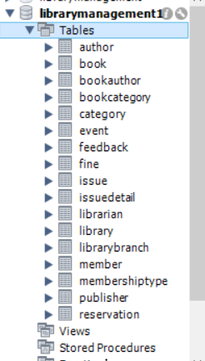
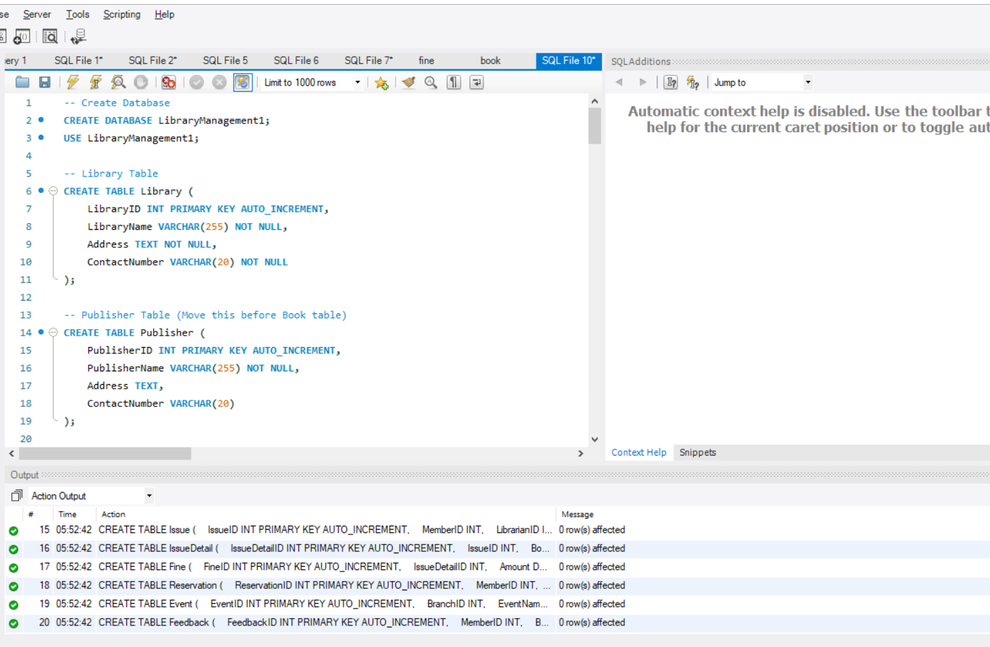
SQL Schema Implementation
We created structured SQL tables covering all necessary entities such as:
Library, Books, Members, Issues, Reservations, Fines, and Librarians are considered as main tables and some child tables are also there in the database design.
Each table was designed with appropriate primary and foreign keys to enforce data integrity and ensure optimized queries.

Slide 10
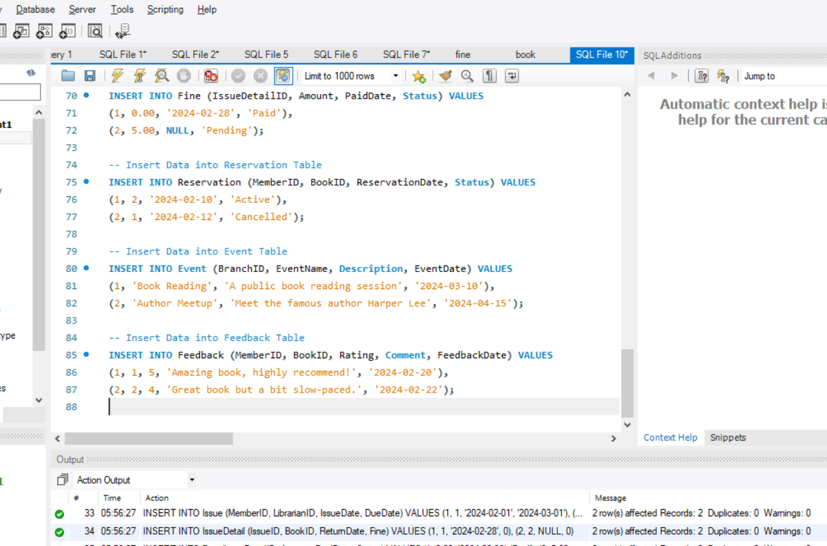
Data seeding
We seeded initial data to test the system effectively

Slide 11
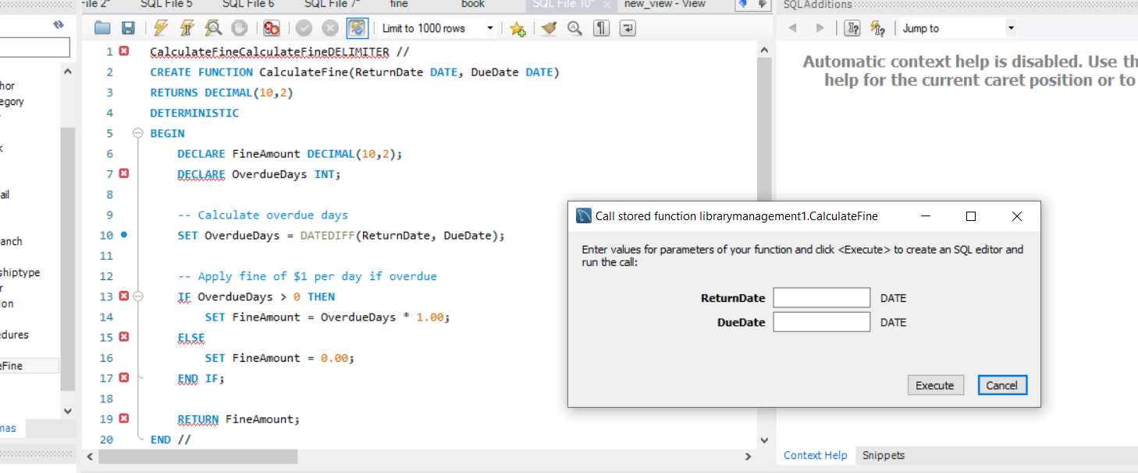
Stored Procedures & Functions
Create the Fine Calculation Function
· Fine Calculation Added "We created CalculateFine to apply $1 per day for late returns."
· Checks Overdue Days "It finds the difference between return and due dates to calculate fines."
· Works in Book Return "When a book is returned, the system checks and applies fines if late."
· Consistent & Reliable "The function always gives the same result for the same input, ensuring fairness."

Slide 12
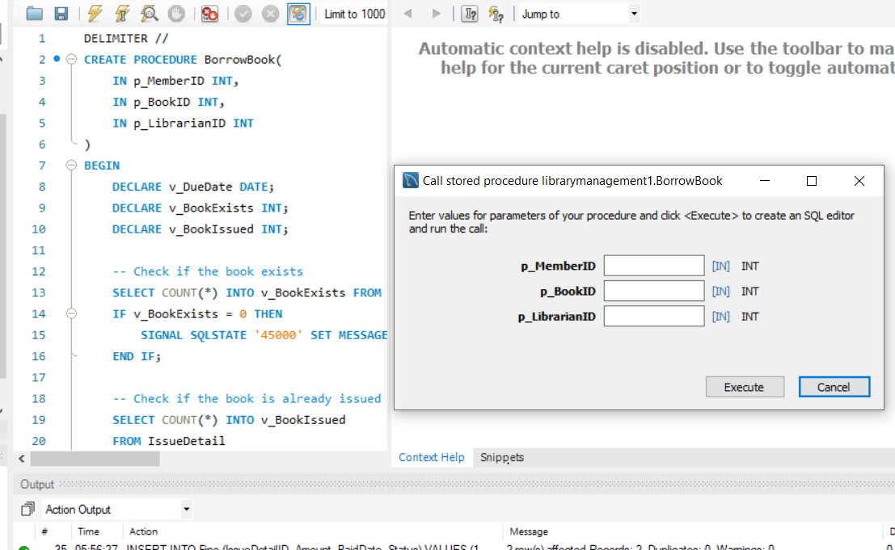
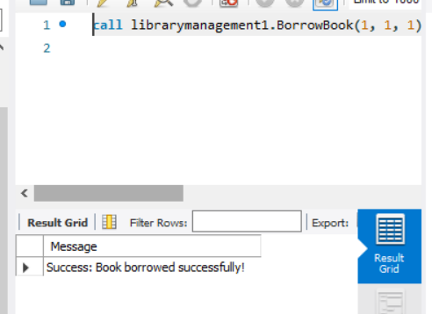
Stored Procedures & Functions
Create the BorrowBook Procedure
We created the BorrowBook procedure to handle book borrowing.
It first checks if the book exists and ensures it is not already issued.
If available, it sets the due date to 30 days from today.
Finally, it records the borrowing details in the Issue and IssueDetail tables. This ensures a proper tracking system for book loans

Slide 13
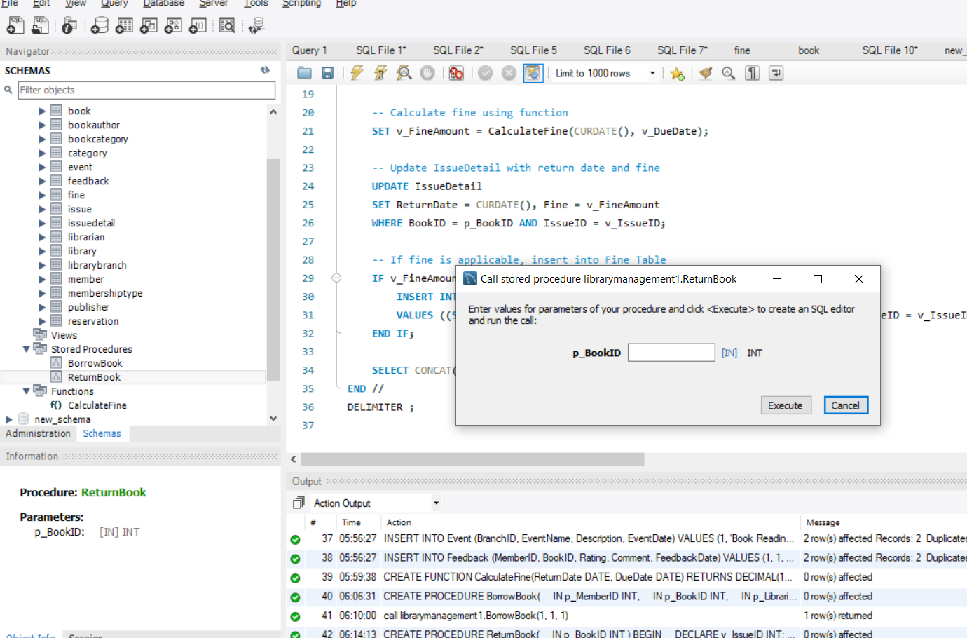
Stored Procedures & Functions
Create the ReturnBook Procedure
We created the ReturnBook procedure to handle book returns.
It first checks if the book is issued and retrieves its due date.
Then, it calculates any applicable fine using the CalculateFine function.
The return date and fine are updated in the IssueDetail table.
If a fine is due, it is recorded in the Fine table with a pending status.

Slide 14
Test Cases Implemented
We executed positive and negative test cases to validate our system:
Successful book borrowing and returning.
Handling non-existing book borrow attempts.
Restricting already borrowed book requests.
Fine application for overdue books.
Ensuring proper database updates. These tests confirmed the system’s reliability and robustness.

Slide 15
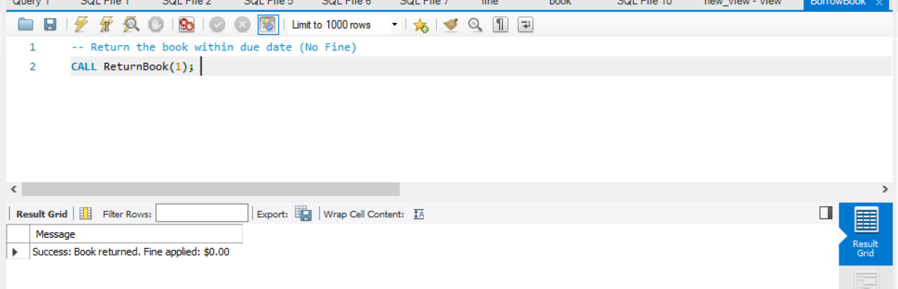
Test Cases Execution
Positive Test Cases
We tested borrowing a book where Member 1 successfully borrows Book 1 with Librarian 1.
Then, we tested returning the book within the due date to check if no fine is applied.
This is a positive test case because the book exists, is available, and is returned on time.
We observed that the return was successful, and no fine was recorded in the system.

Slide 16
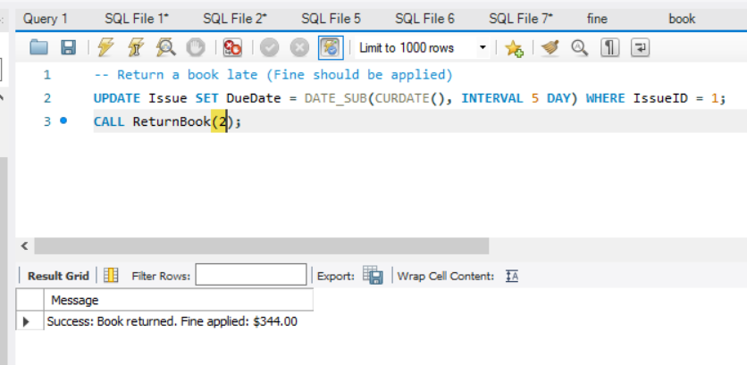
Test Cases Execution
Negative Test Cases
We tested borrowing a non-existing book (Book ID 999). The system correctly rejected the request, confirming that only valid books can be borrowed.
We tested borrowing a book that was already issued. The system blocked the request, ensuring a book cannot be borrowed twice before being returned.
We tested returning a book that was never borrowed. The system prevented the operation, verifying that only issued books can be returned.
We tested returning a book after the due date. The system applied a fine, confirming that overdue books incur penalties as expected.

Slide 17
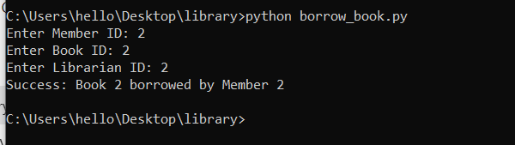
Python script to call stored procedure (barrowing a book )
We executed and ran the python script to test borrowing a book.
The script asked for Member ID, Book ID, and Librarian ID. We entered (2, 2, 2).
It connected to the LibraryManagement1 database and executed the BorrowBook(2, 2, 2) procedure.
The procedure checked if the book exists, is available, and if the member can borrow it.
After validation, the Issue and IssueDetail tables were updated with the borrowing details.
The script displayed "Success: Book 2 borrowed by Member 2", confirming the transaction.
The database connection was closed, and the script completed successfully.

Slide 18
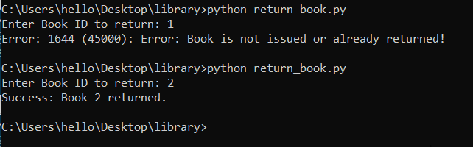
Python script to call stored procedure (returning a book )
We executed the return_book.py script to test the book return process.
The script asked for a Book ID, and we entered 1 first.
The database checked if the book was issued and found that Book 1 was not issued or already returned, triggering an error message.
We then entered Book ID 2, and the ReturnBook procedure processed the return.
The script updated the IssueDetail table with the return date and checked for fines.
Since no overdue fine was applied, the script confirmed "Success: Book 2 returned."
The test validated that only issued books can be returned, ensuring system accuracy.

Slide 19
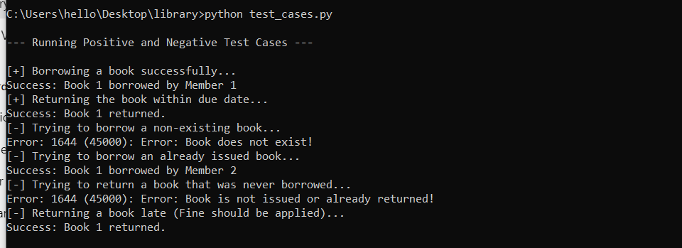
Python script to call or run test cases
The script tested borrowing and returning books.
Book 1 was borrowed by Member 1 successfully.
Book 1 was returned on time without a fine.
Borrowing a non-existing book (ID 999) failed as expected.
Book 1 was borrowed again by Member 2 after being returned.
Returning a book that was never issued (ID 999) resulted in an error.
The due date was modified to simulate a late return, and a fine was applied.
The tests confirmed that borrowing, returning, and fine calculations work correctly.

Slide 20
Conclusion
We created a Library Management System to handle book borrowing, returns, and fines efficiently.
Our team designed and implemented a relational database using MySQL to ensure structured data storage.
We developed stored procedures to automate borrowing, returning, and fine calculations, reducing manual errors.
Extensive testing was conducted, including positive and negative test cases, to validate system functionality.
Challenges like handling concurrent transactions and ensuring data integrity were encountered and resolved.
Team collaboration played a key role in debugging issues, optimizing queries, and refining stored procedures.
The Database Management System (DBMS) proved essential in maintaining data consistency and improving performance.
This project highlighted the importance of efficient database design in real-world applications like library management.

Slide 21
References
Rathour, S. S., & Dewangan, O. (2024). Library management system. International Journal of Novel Research and Development, 9(5), e588-c588. https://www.ijnrd.org
Taipalus, T. (2024). Database management system performance comparisons: A systematic literature review. Journal of Systems and Software, 208, 111872. https://doi.org/10.1016/j.jss.2023.111872

